Slide 1
LEARNING TO TEACH TEACHING TO LEARN
Modern First-Year Math Education in Engineering
We welcome all questions. Our specialties are listed below, but please do not hesitate to contact any of us.
Sa’diyya Hendrickson - sadiyya.parnell.hendrickson@mail.utoronto.ca - Learning to Learn
Shai Cohen – sh.cohen@utoronto.ca - Extracurricular resources, T-program
Fabian Parsch - fabian.parsch@utoronto.ca - Active Learning Cycle (PCEs and Teamwork)
Camelia Karimian Pour - camelia.karimian@utoronto.ca - Linear Algebra, MATLAB:
Sean Uppal - sean.uppal@utoronto.ca - Calculus I

Slide 2
Purpose Of This Presentation
We are …
… teachers and coordinators of the first year math courses for Core 8
… from the Department of Mathematics and ISTEP
We wish to …
...make the faculty more aware of the changes in the first-year mathematics courses in FASE over the past decade and demonstrate what additional resources would further support student learning in this new framework.
...showcase the most recent changes and the direction in which they lead.
...begin discussions about what other courses, in first year and in later years, feel has worked and what they think can be done to improve our efforts.

Slide 3
The Setting
Course code | Course title | Semester | Enrollment
APS 162 | Calculus I | Summer | ~150
APS 163 | Calculus II | Fall | ~60
MAT 186 | Calculus I | Fall | ~850
MAT 188 | Linear Algebra | Fall | ~1000
MAT 187 | Calculus II | Winter | ~950
MAT 186T | Calculus I | Winter | ~50
MAT 188T | Linear Algebra | Winter | ~50
MAT 187T | Calculus II | Summer | ~80

Slide 4
Student Context
We are teaching students …
… with diverse mathematical background
… with very different lived experiences
Rather frequently, we encounter …
… less mathematical maturity
… the idea that math is about “plug and chug” and following recipes
… ingrained passive learning practices
… lack of learning skills
… feelings of anxiety and being overwhelmed

Slide 5
Program Wide Changes
Concepts over computations
Qualitative results over quantitative results
Mathematical modeling and problem-solving
Resources added
Better TA/student ratio
Math Success Program
Math self-assessment
ePUMP (Preparing for University Math Program)
Multiple paths to success
Less “tentpole” assignments with heavy weight
Regular engagement with material
Standard- and attribute-based grading
Collaboration and communication
Teamwork
Writing mathematics
Math as a language
Assigned seating in MY150

Slide 6
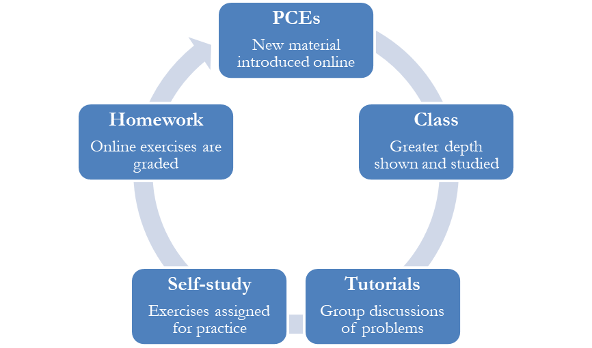
The Active Learning Cycle
Note: PCE = Pre-Class Essentials

Slide 7
Calculus II
A quote from the syllabus:
We want to train you in the art of teamwork and communication. As future engineers, you will serve an important role at the boundary between science and its applications.
You will have to talk to business partners, manufacturers, designers, construction workers, investors.
You will need to be able not just to arrive at correct mathematical answers but make others understand you, believe you, and trust you.

Slide 8
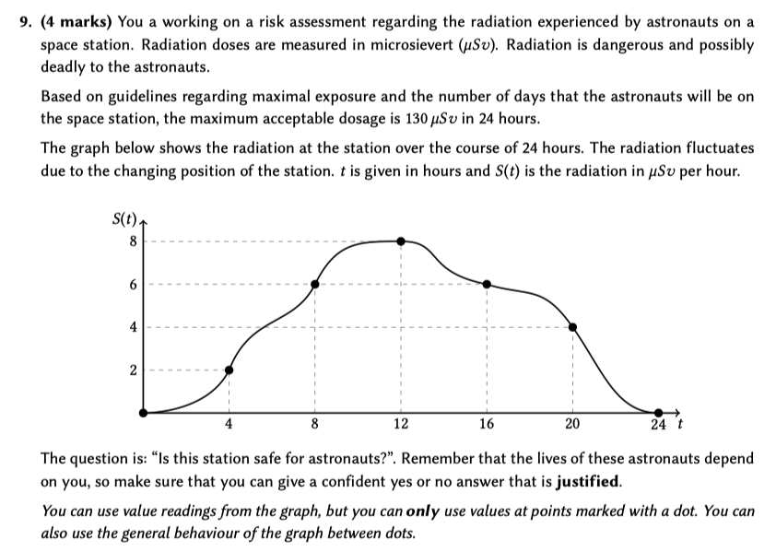
Calculus II
2022 Term Test 1 - Numerical integration
A quote from the syllabus:
We want to train you in the art of teamwork and communication. As future engineers, you will serve an important role at the boundary between science and its applications.
You will have to talk to business partners, manufacturers, designers, construction workers, investors.
You will need to be able not just to arrive at correct mathematical answers but make others understand you, believe you, and trust you.

Slide 9
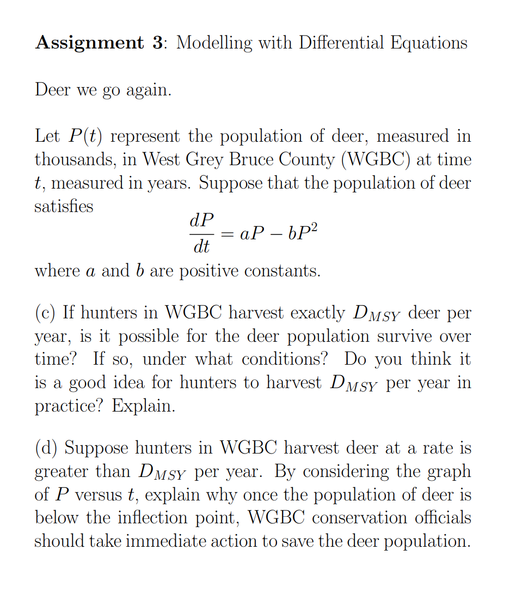
Calculus I

Slide 10
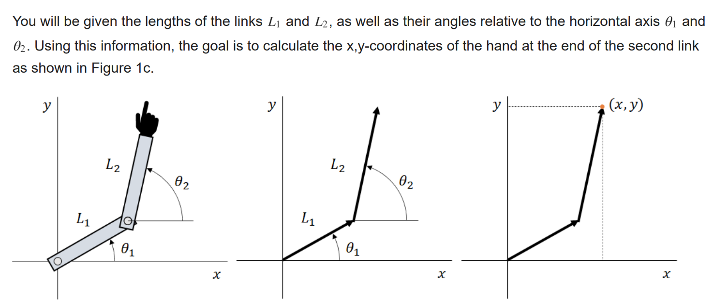
Linear Algebra
Instructor support
Lecture tasks
Learning standards
Mastery-based grading
Standard grading in tutorials
Online gateway exams
MATLAB projects
(project 2, Fall 2022)

Slide 11
Concerns And Requests
Assessments
We aim to teach skills and virtues that are not easy to assess via traditional exams
Modern assessments (Gateway exams, standard-based grading) requires resources and flexible policies
Workload concerns
Not enough time to properly treat the concepts and no time to learn to retain
For example, in Linear Algebra: from vectors in 2D to singular value decomposition + MATLAB in one term
Possible solutions
Linear Algebra I and II + MATLAB
A year-long separate course on MATLAB

Slide 12
The Counterpart: Teaching To Learn
The teaching of the courses has been improved, but we can also show the students how to become improved learners.
Learning how to learn
Through open and explicit communication, we can:
Foster a productive disposition – the understanding that math is a learned skill and is fundamental to becoming a better engineer.
Help students become self-regulated learners
This is already happening in subtle ways in our courses, but there is great benefit in making Learning How to Learn an explicit part of our course structures.

Slide 13
Examples
Fostering productive disposition:
Providing materials that address:
students’ experiences and mental health
university resources
the nature of math and how to learn it
active learning and its benefits
Supporting self-regulated learners:
Offering resources that include:
math-specific learning strategies
pre-class, in-class, and after-class training checklists
Learning How to Learn (LHL) corner in lecture slides
how to get math help outside of class
tutorials that reinforce active learning practices

Slide 14
Examples
Fostering productive disposition:
Providing materials that address:
students’ experiences and mental health
university resources
the nature of math and how to learn it
active learning and its benefits
Supporting self-regulated learners:
Offering resources that include:
math-specific learning strategies
pre-class, in-class, and after-class training checklists
Learning How to Learn (LHL) corner in lecture slides
how to get math help outside of class
tutorials that reinforce active learning practices

Slide 15
Examples
Fostering productive disposition:
Providing materials that address:
students’ experiences and mental health
university resources
the nature of math and how to learn it
active learning and its benefits
Supporting self-regulated learners:
Offering resources that include:
math-specific learning strategies
pre-class, in-class, and after-class training checklists
Learning How to Learn (LHL) corner in lecture slides
how to get math help outside of class
tutorials that reinforce active learning practices

Slide 16
Examples
Fostering productive disposition:
Providing materials that address:
students’ experiences and mental health
university resources
the nature of math and how to learn it
active learning and its benefits
Supporting self-regulated learners:
Offering resources that include:
math-specific learning strategies
pre-class, in-class, and after-class training checklists
Learning How to Learn (LHL) corner in lecture slides
how to get math help outside of class
tutorials that reinforce active learning practices

Slide 17
Next steps: some conversation starters
Help students prepare for the university learning experience by integrating in-class support of learning skills, existing and additional external resources, and peer support groups.
Adopt new policies on grades that strengthen incentives for struggling students to find and use available resources.
Create a dialogue with students across their courses that discusses active learning, aiming to reduce their frustration and resistance.

Slide 18
LEARNING TO TEACH TEACHING TO LEARN
Modern First-Year Math Education in Engineering
Thank you!
Camelia Karimian Pour Shai Cohen Sa’diyya Hendrickson
Fabian Parsch Sean Uppal

